Slide 1
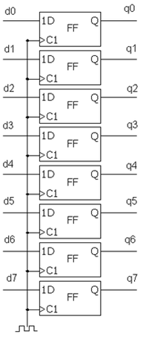

Slide 2
Trigger
Trigger Type
‘0’
Trigger Position
Clk to start
Reset
System status
Trigger Type
Trigger Position
Clk to start
System status
Clk

